Slide 1
Minimization of Deterministic Finite Automata (DFA)
By
Ms. P.Malathi
Assistant Professor(Sr.Gr), CSE Dept,
ASE, CBE

Slide 2
Minimization of DFA (Table Filling Method or Myhill-Nerode Theorem)

Slide 3
Steps:
Identify and remove the unreachable states. These are the states with no incoming transition, but only outgoing transition.
Draw a table for all pairs of states (P, Q)
Consider all pairs where Pϵ F and Q∉F as distinguishable states and mark them as “+” in the table.
If there are any Unmarked pairs (P, Q) such that [δ(P, x),δ(Q, x)] is marked, then mark [P, Q] where ‘x’ belongs to ∑ an alphabet set. Repeat this until no more marking can be made.
Combine the indistinguishable pairs and make them a single state in the minimized DFA.

Slide 4
Example: Minimize the following DFA using Table Filling Method.

Slide 5
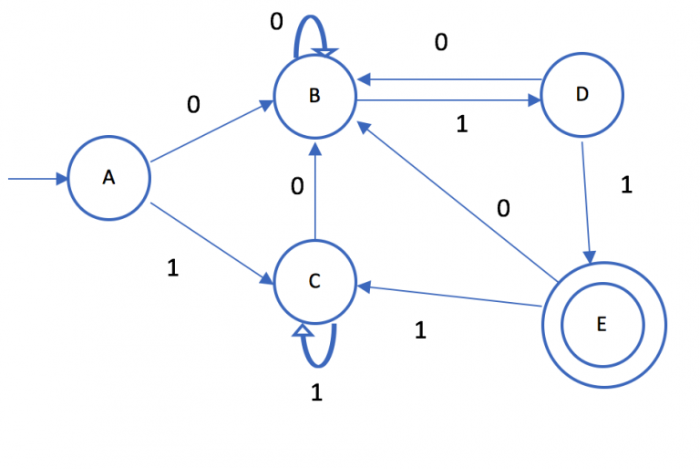

Slide 6
Step 1: Draw a table for all pairs of states.

Slide 7


Slide 8
Step 2: Mark all pairs where Aϵ F and B∉F are distinguishable.

Slide 9


Slide 10
Step 3: If there are any Unmarked pairs (A, B) such that [δ(A, x),δ(B, x)] is marked, then mark [P, Q] where ‘x’ belongs to ∑ an alphabet set. Repeat this until no more marking can be made.

Slide 11
Consider the pair(B,A) for input 0 & 1
(B,0) = B (B,1) = D
(A,0) =B (A,1) = C
Consider the pair(D,C) for input 0 & 1
(D,0) = B (D,1) = E
(C,0) = B (C,1) = C
Since (E,C) are already marked distinguishable, therefore (D,C) as well as (B,A) are also distinguishable.
Same state
Different states so need to check those two states are distinguishable with step3

Slide 12
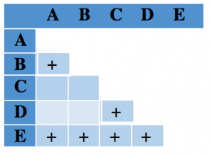

Slide 13
Consider the pair(C,A) for input 0 & 1
(C,0) = B (C,1) = C
(A,0) =B (A,1) = C
Since both the pairs(B,B) and (C,C) are same state, therefore the pair(C,A) are not distinguishable.

Slide 15
Consider the pair(D,A) for input 0 & 1
(D,0) = B (D,1) = E
(A,0) =B (A,1) = B
Since the pair(B,B) are same state, consider the pair(E,B) which are already marked distinguishable, therefore (D,A) to be marked as distinguishable.

Slide 16
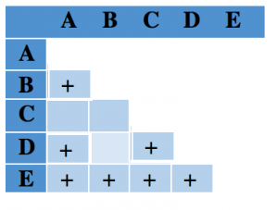

Slide 17
Consider the pair(C,B) for input 0 & 1
(C,0) = B (C,1) = C
(B,0) =B (B,1) = D
Since the pair(B,B) are same state, consider the pair(C,D) which are already marked distinguishable, therefore (C,B) to be marked as distinguishable.

Slide 18
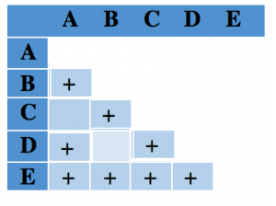

Slide 19
Consider the pair(D,B) for input 0 & 1
(D,0) = B (D,1) = E
(B,0) =B (B,1) = D
Since the pair(B,B) are same state, consider the pair(E,D) which are already marked distinguishable, therefore (D,B) to be marked as distinguishable.

Slide 20
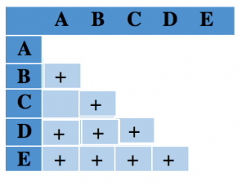

Slide 21
Step 4:Combine the indistinguishable pairs and make them a single state in the minimized DFA.

Slide 22
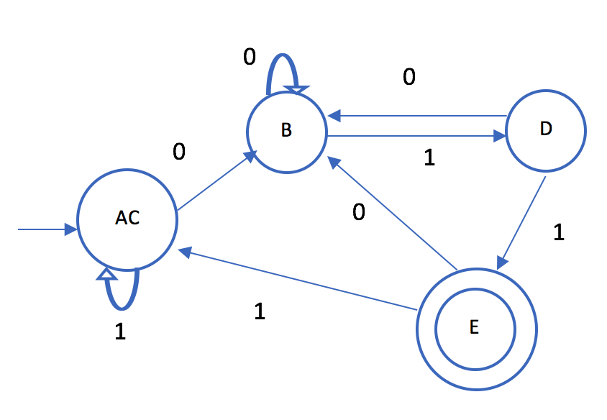
Step 4 :(A, C), B, D, E

Slide 23
Assignment
Please refer
PM_Assignment_minimization_DFA

Slide 24
Thank You

